Slide 1
Welcome to My Presentation
Presented By
MD. SOLAMAN ALI

Slide 2
Presentation topic
My Biography

Slide 3
Overview
My Basic Info
My Family
My Education
Goal
Skills
Hobbies

Slide 4
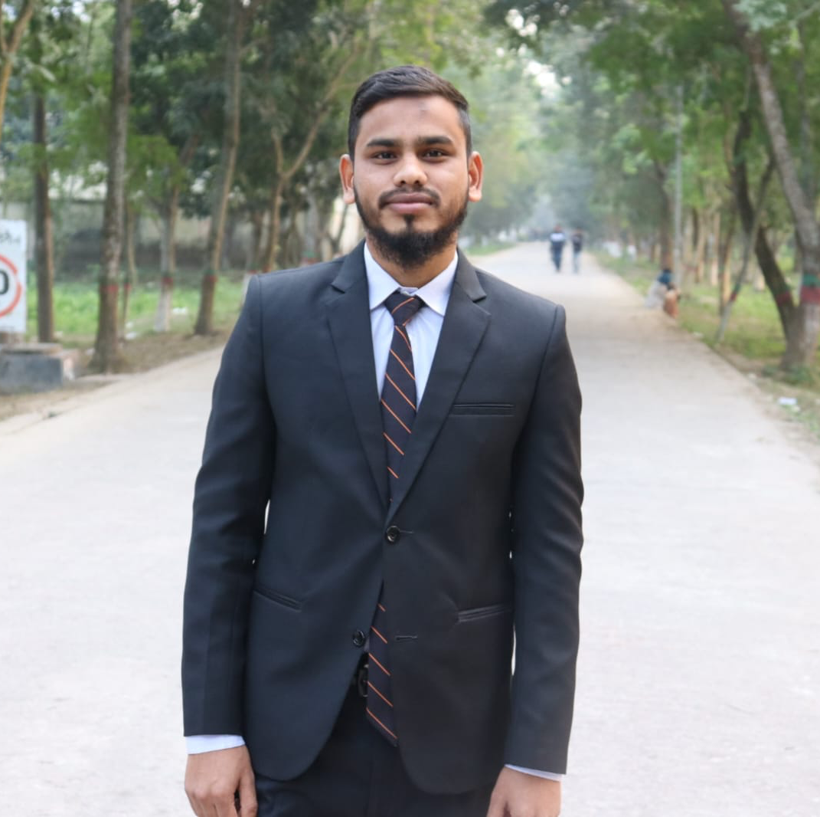
My Basic Info
Hello! I am Md Soleman Ali. I'm bron in Panchagarh on 7th September 1998. Presently I am staying in Rangpur for studies.

Slide 5
My Family
There are five members in my family. I am the second child in my family. I have two sisters. My family is lower middle class. My father is a shopkeeper and my mother is a housewife.

Slide 6
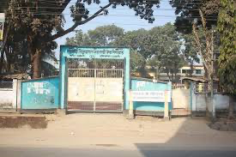
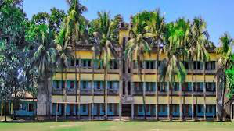
My Education
My High School
My College
I passed SSC from Panchagarh B.P Govt. High School in 2015.
I passed HSC from Barrister Zamir Uddin College in 2017.

Slide 7
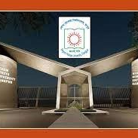
My Education
Last year I completed Graduation and post-Graduation at Begum Rokeya University, Rangpur.

Slide 8

My Goal
Go back to Allah and get Jannah.

Slide 9

Skills
I can do computer Microsoft office word, Excel work and power point work. I can web sites browsing in computer.

Slide 10

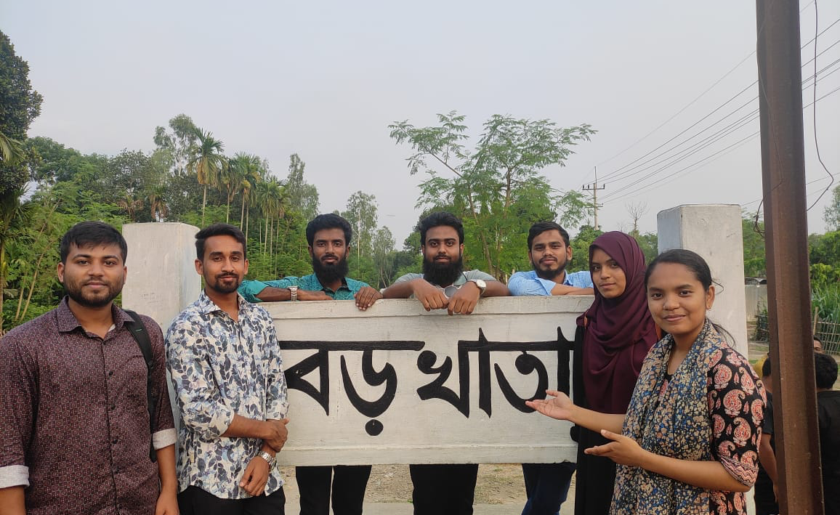
Hobbies
My hobbies is reading Islamic books.
Playing cricket and football
Traveling with friends.

Slide 11
Thank you
Allah Hafez.

